Slide 1

Module 4 –Spark Streaming

Slide 2

Spark Streaming
Question No:7
Do you understand stateful and stateless transformations in Spark Streaming? If so identify the transformation that needs to be performed for the given scenario.
Consider a Dstream on stock quotes that contain a sequence of tuples that contain <company name, stock sold>
What’s the max amount of stock sold across the whole day for a company?

Slide 3


Stateful and Stateless Stream Processing
SPARK STREAMING
Stateless
Stateful

Slide 4
Stateless Transformation
SPARK STREAMING
RDD1
RDD2
RDD3
RDD4
RDD5
No need to store any state for transformation
Map()
FlatMap()
Filter()
Repartition()
reduceByKey()
groupByKey()

Slide 5
SPARK STREAMING
Class Exercise : Stateless stream processing (10 mins)
Consider a Dstream on stock quotes generated similar to earlier that contains
A sequence of tuples that contain <company name, stock sold>
Need to find total shares sold per company in the last 1 minute
Show Streaming spark design for the same.

Slide 6
SPARK STREAMING
Solution – count stock in every window
batch @ t
batch @ t+1
batch @ t+2
Stocks sold Stream
map
map
map
hashTags DStream
count
count
count
every batch processed independently, so no state across time

Slide 7

SPARK STREAMING
Example 1 – Get hashtags from Twitter
val tweets = ssc.twitterStream(<Twitter username>, <Twitter password>)
val hashTags = tweets.flatMap (status => getTags(status))
hashTags.saveAsHadoopFiles("hdfs://...")
output operation: to push data to external storage
tweets DStream
batch @ t
batch @ t+1
batch @ t+2
flatMap
flatMap
flatMap
hashTags DStream
Every batch saved to HDFS
save
save
save

Slide 8
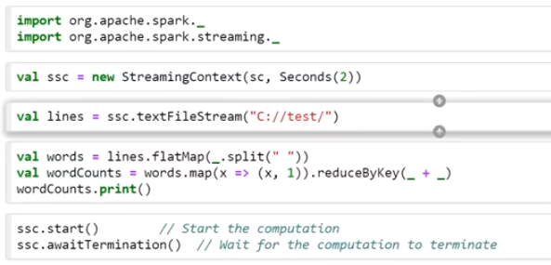
How does the code works?
SPARK STREAMING

Slide 9
Stateful Transformation
SPARK STREAMING
Let's consider the traditional word count problem
What was the count of words in last one hour?
RDD 1
RDD 2
RDD 3
RDD 4
RDD 5

Slide 10
SPARK STREAMING
Count the hashtags over last 10 mins
val tweets = ssc.twitterStream(<Twitter username>, <Twitter password>)
val hashTags = tweets.flatMap (status => getTags(status))
val tagCounts = hashTags.window(Minutes(10), Seconds(1)).countByValue()
sliding window operation
window length
sliding interval

Slide 11
SPARK STREAMING
Counting the hashtags over last 10 mins
val tagCounts = hashTags.window(Minutes(10),Seconds(1)).countByValue()
t-1
t
t+1
t+2
t+3
hashTags
sliding window
countByValue
count over all the data in the window
tagCounts

Slide 12
SPARK STREAMING
Smart window-based countByValue
val tagCounts = hashtags.countByValueAndWindow(Minutes(10), Seconds(1))
t-1
t
t+1
t+2
t+3
hashTags
countByValue
add the counts from the new batch in the window
subtract the counts from batch before the window
–
+
tagCounts
+
?

Slide 13
Stateful Transformation Operations
SPARK STREAMING
UpdateStateByKey Operation
The updateStateByKey operation allows you to maintain arbitrary state while continuously updating it with new information.
To use this, you will have to do two steps.
Define the state - The state can be an arbitrary data type.
Define the state update function - Specify with a function how to update the state using the previous state and the new values from an input stream.
In every batch, Spark will apply the state update function for all existing keys, regardless of whether they have new data in a batch or not. If the update function returns None then the key-value pair will be eliminated.

Slide 14
Stateful Transformation Operations
SPARK STREAMING
UpdateStateByKey Operation
you want to maintain a running count of each word seen in a text data stream
What is state here?
def updateFunction(newValues, runningCount):
if runningCount is None:
runningCount = 0
return sum(newValues, runningCount)
runningCounts = pairs.updateStateByKey(updateFunction)

Slide 15
Transform Operation
SPARK STREAMING
spamInfoRDD = sc.pickleFile(...) # RDD containing spam information
# join data stream with spam information to do data cleaning
cleanedDStream = wordCounts.transform(lambda rdd: rdd.join(spamInfoRDD).filter(...))

Slide 16
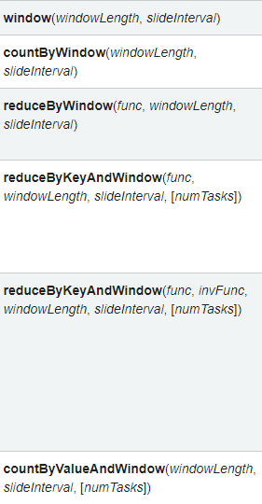
Window Operations
SPARK STREAMING

Slide 17



Join Operations
SPARK STREAMING

Slide 18
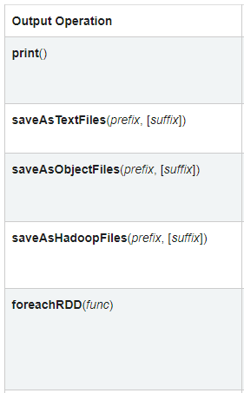
Output Operations
SPARK STREAMING

Slide 19
BIG DATA
Fault Tolerance
What happens if there is a failure with
Stateless processing
Stateful processing
Stateless
Previous history is not required.
Processing can just be recomputed
Stateful
State from previous batches required for computation.
How much state to retain?

Slide 20
BIG DATA
Checkpointing
Sometimes there may be too much data to be stored
For a streaming algorithm, may have to store all the streams
Checkpointing
Stores an RDD
Forgets the lineage
A checkpoint at t+2 will
store the hashTags and tagCounts at t+2
Forget the rest of the lineage
t-1
t
t+1
t+2
t+3
hashTags
tagCounts
Checkpoint

Slide 21
THANK YOU

